Slide 1



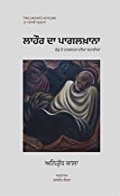





College Library,
Goswami Ganesh Dutta
Sanatan Dharma College, Chandigarh
Books of the Month
June 2023

